Slide 1


How Long To Beat
DATABASE 2 - GROUP PROJECT
BORWEI HUANG, MATTEO LANDO, DANIEL LUPU, ENRICO SGARBOSSA
Master’s Degree in Computer Engineering Academic Year 2022/2023

Slide 2
Source datasets
games.csv and completion_time.csv → game data and from www.howlongtobeat.com. Retrieved from https://www.kaggle.com/datasets/kasumil5x/howlongtobeat-games-completion-times
indie-game-developers.csv and video-games-developers.csv → developer names with the headquarters country and notable games. Retrieved from https://www.kaggle.com/datasets/andreshg/videogamescompaniesregions
vgchartz-7_7_2020.csv → sales data for videogames present on the vgchartz website. Retrieved from https://www.kaggle.com/datasets/baynebrannen/video-game-sales-2020
plaforms/console_sales_vgchartz.csv → sales data for console platforms. Retreived from the web page https://www.vgchartz.com/charts/platform_totals/Hardware.php/
plaforms/platforms_hltb.txt and platforms/popular_platforms_hltb.txt → list of console platforms available on the howlongtobeat website. Retrieved from https://howlongtobeat.com/stats
platforms/platforms_wikipedia.csv table with console platforms information. Retrieved from https://en.wikipedia.org/wiki/Home_video_game_console#Released_systems

Slide 3

Completion time
Each game is being played on a platform, for example Playstation 3.
Users insert their completion status (main story, main story plus, 100%) and the completion time into the website. Number of users that inserted data for a given game and platform referred to as “polledTime”.
We used Scrapy, a Python library to crawl the website and extract this information, based on the IDs we have in “games.csv”.

Slide 4
Mixed merging approach
Games and their completion time have the same source website (www.howlongtobeat.com) → Exact match
Games, Platforms and Companies are entities that have a registered official name in the real world → Exact match
Same resource with alternative names from different datasets → Duplicates

Slide 5
Entity matching
Datasets refers to the same entity with different names → Manual match
Use of python dictionary …

Slide 6
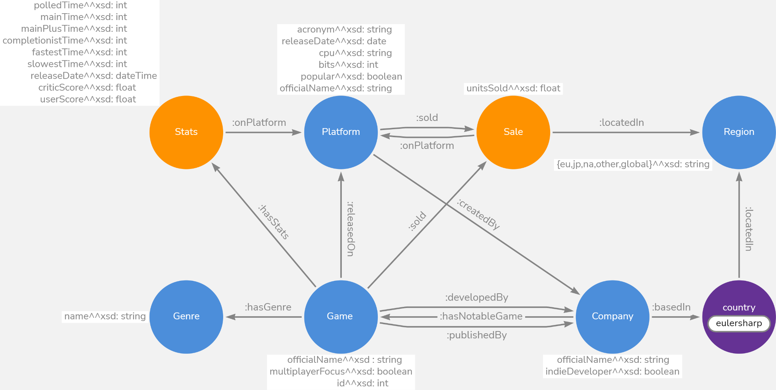
Model

Slide 7
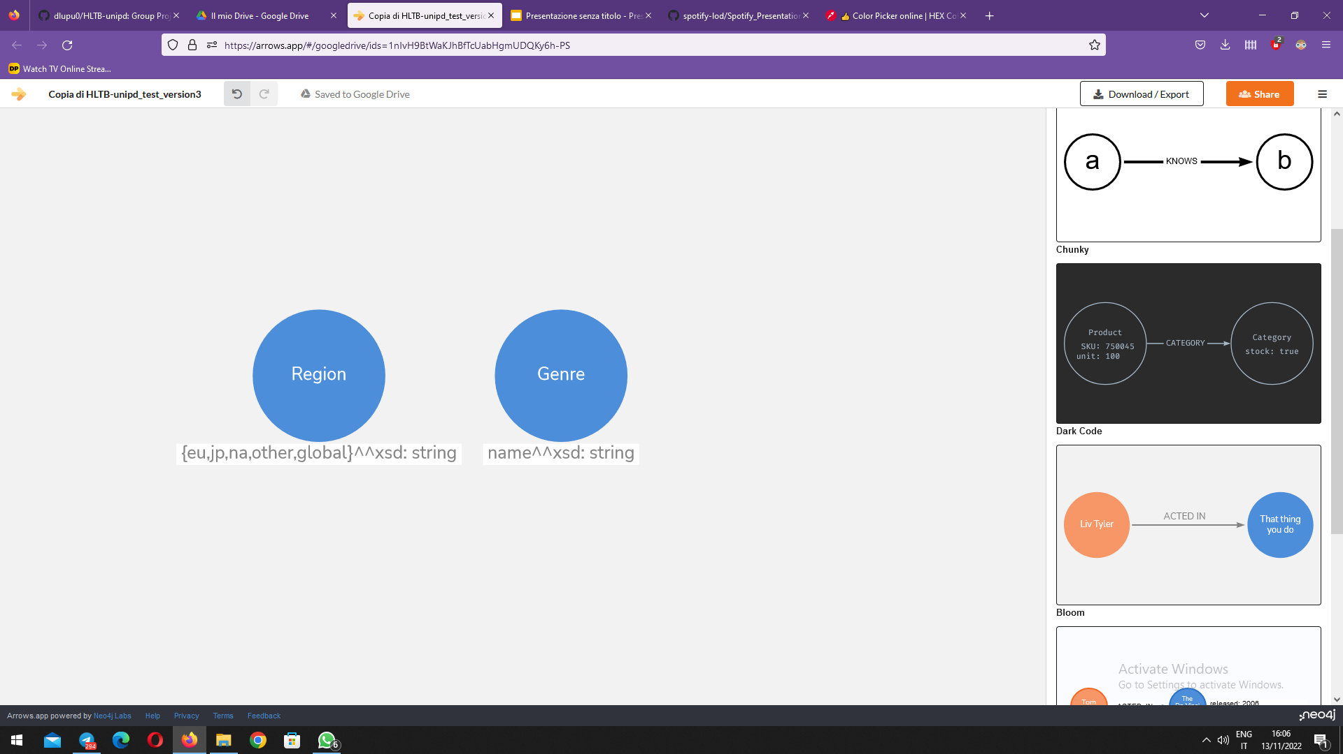
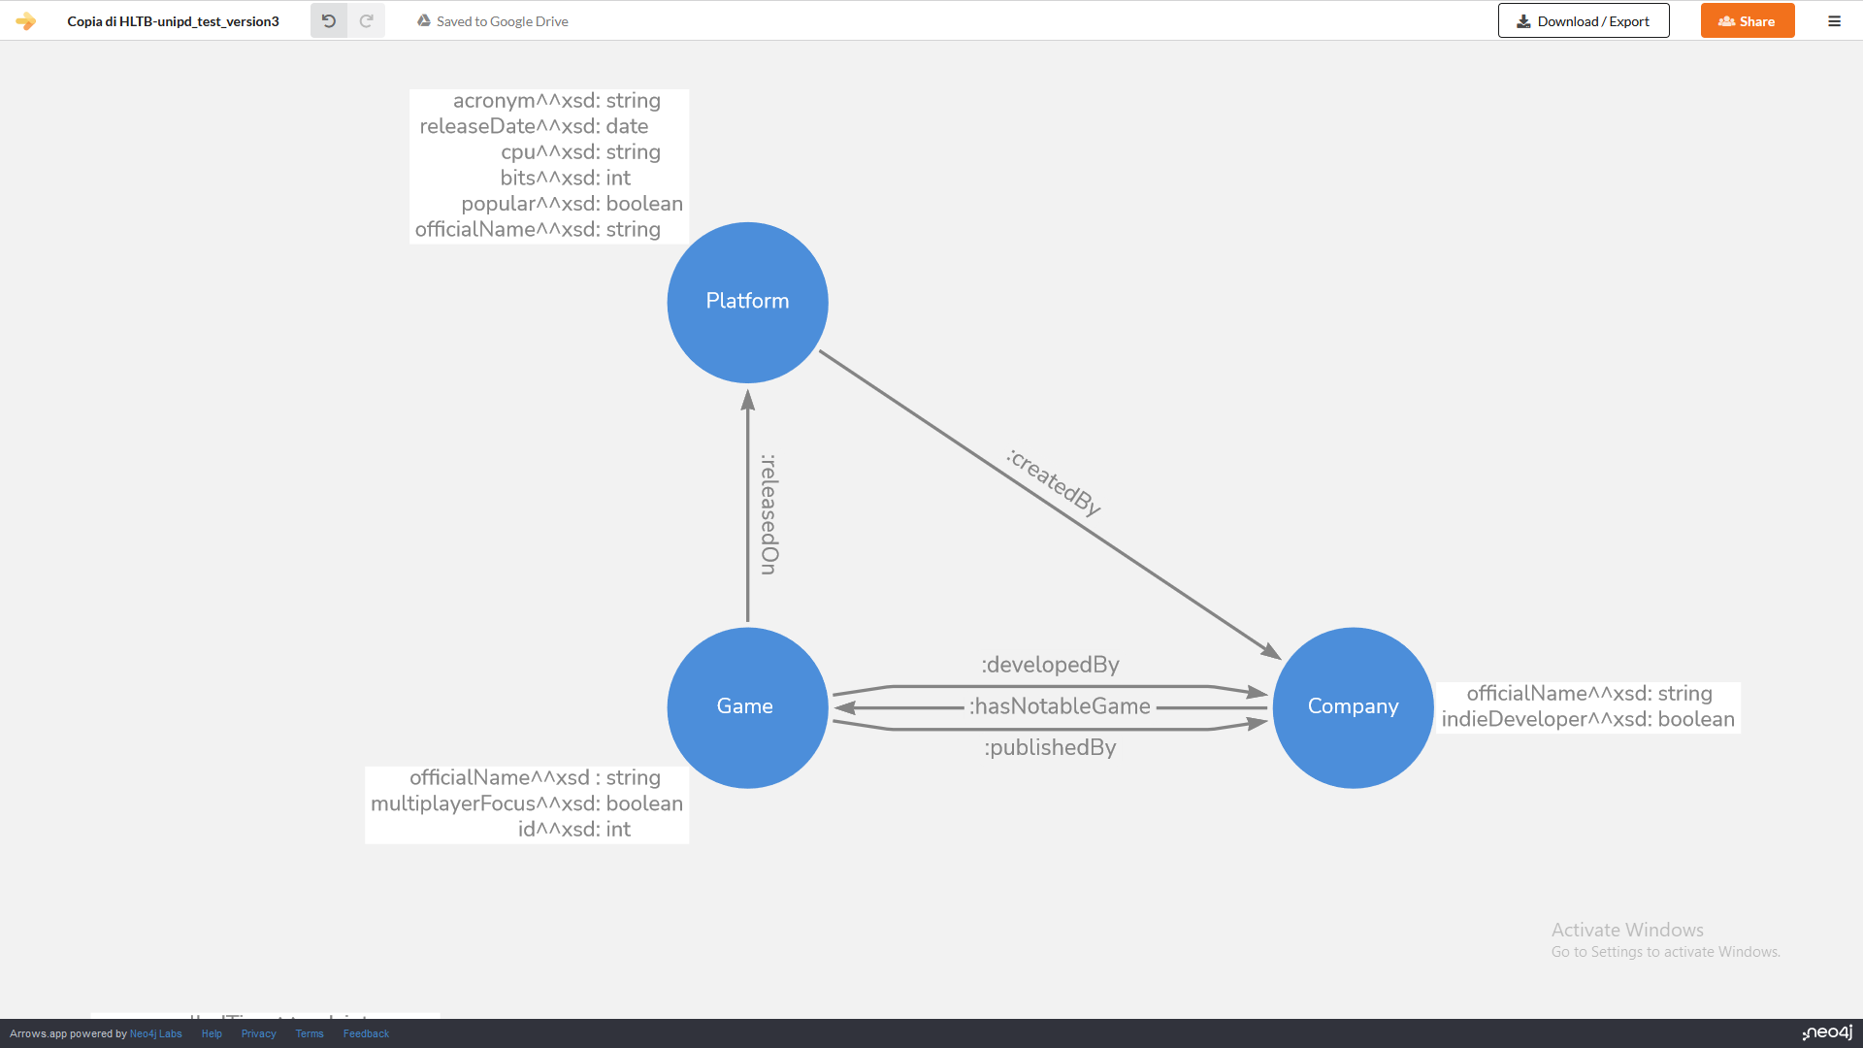
Focus I
Beat 'em Up, Beat 'em up and beat 'em up identified by URI :beat--em-up
NOT AN ENUMERATION
Company represents both developers and platform manufacturers
Using names to identify resources and not numbers.
e.g. hltb:the-last-of-us
ENUMERATION

Slide 8
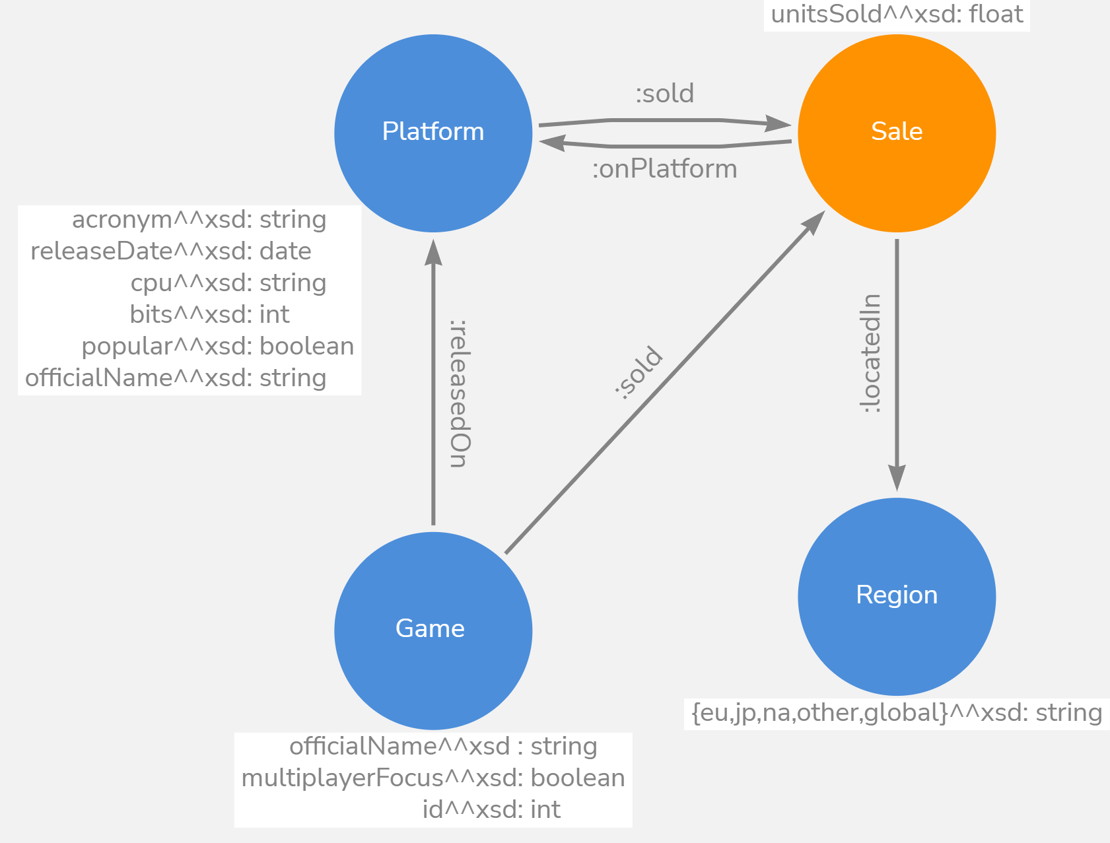
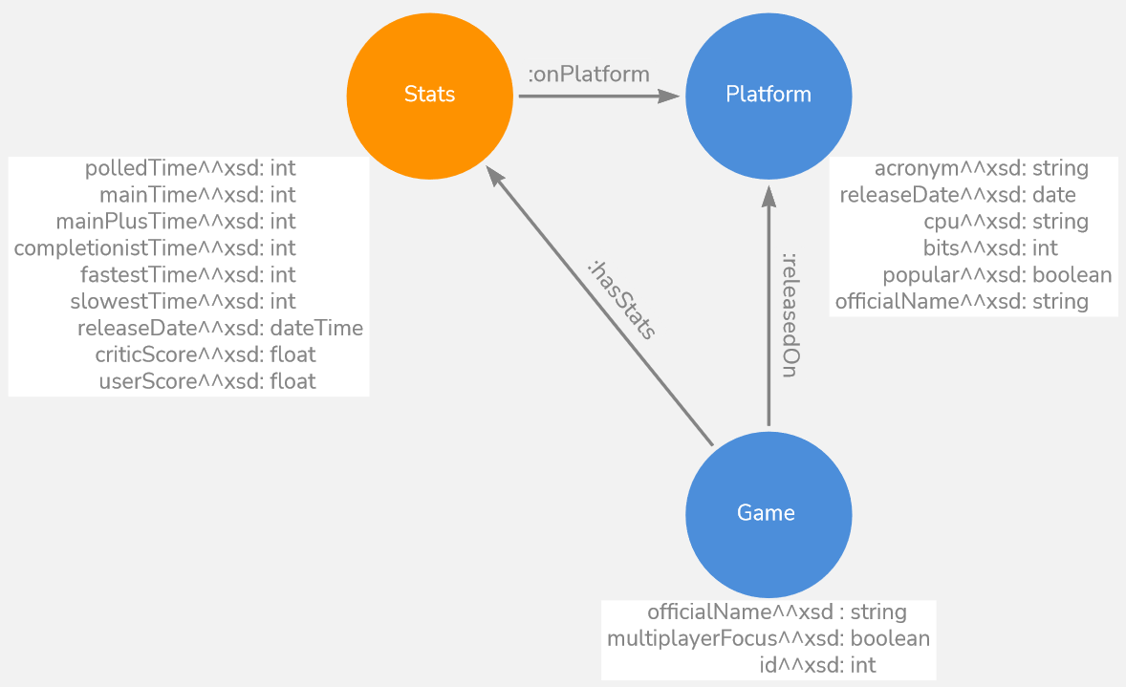
Focus II
unitsSold exactly 1 xsd:float,
so cannot be blank
Dummy node to represent statistics about a game on a given platform
Dummy node to represent sold units of a given game on a platform and in a region

Slide 9
Generation of ttl files
Load CSV files
Process initial datasets: remove unused columns and merge some of them
Import dataset CSVs into panda dataframes
ID creation for each node: Removing blank space and special characters.
Example: “Kiro'o Games” -> “kiro-o-games”
Add all data and object properties (sometimes runtime dataframes merge still needed)
Serialize to turtle files, one for each class
Add all data and object properties (sometimes runtime dataframes merge still needed)

Slide 10
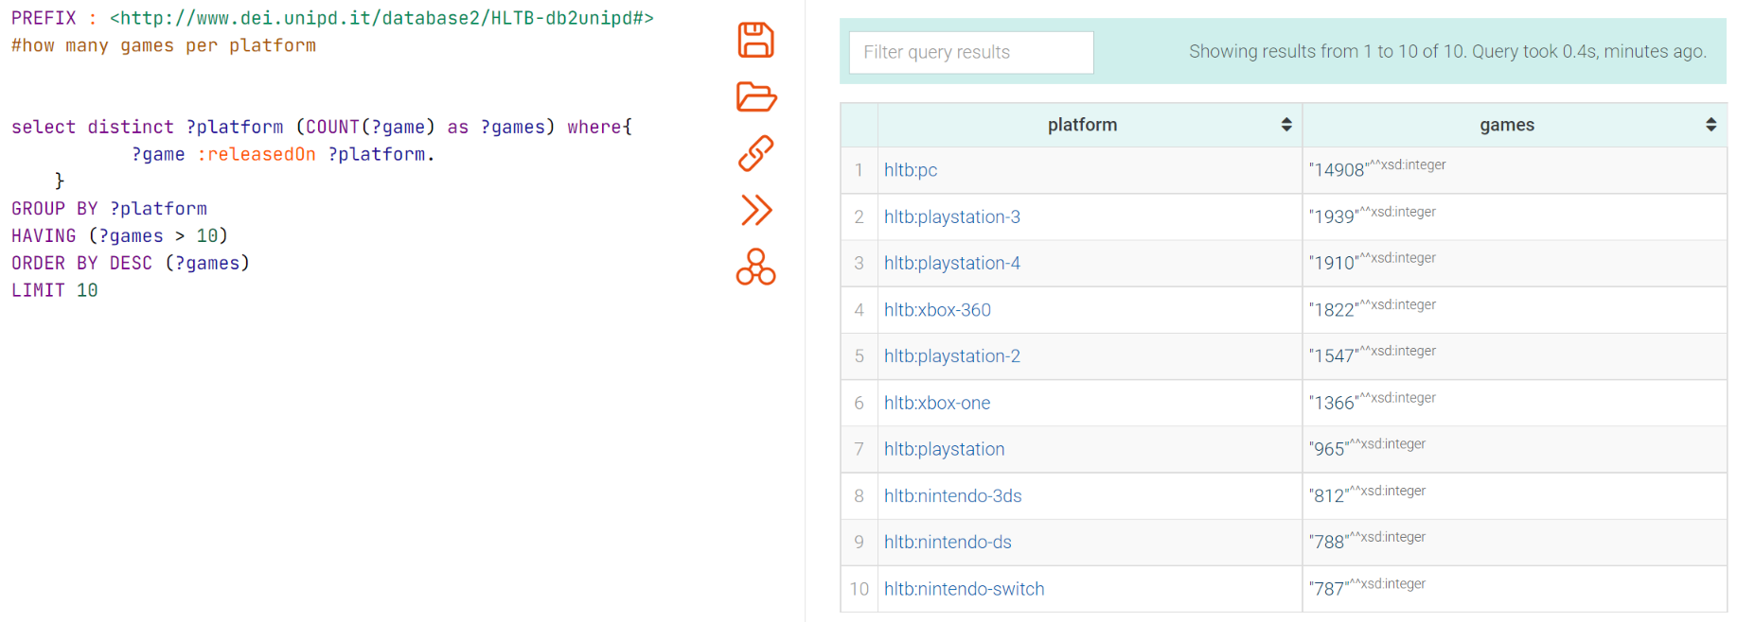
Query 1 - How many games per platform?

Slide 11
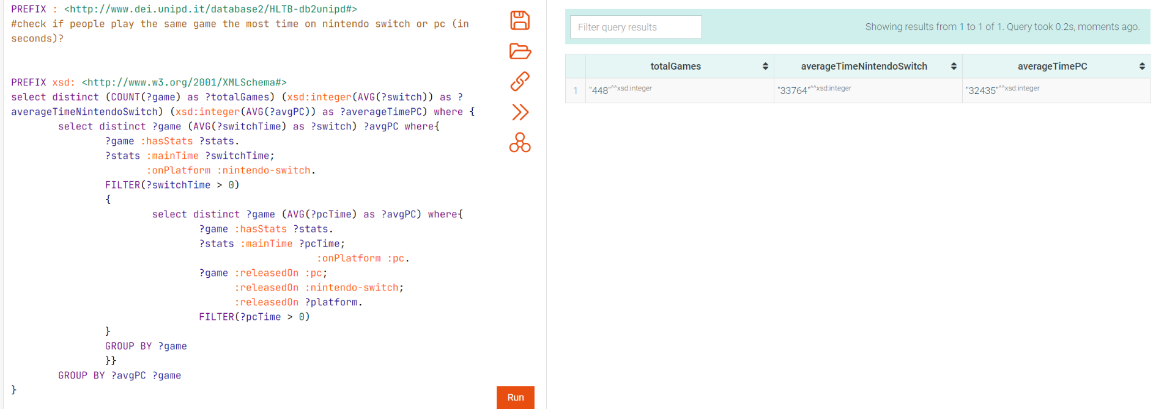
Query 2 - Do people play the same game the most time on Nintendo Switch or on PC?

Slide 12
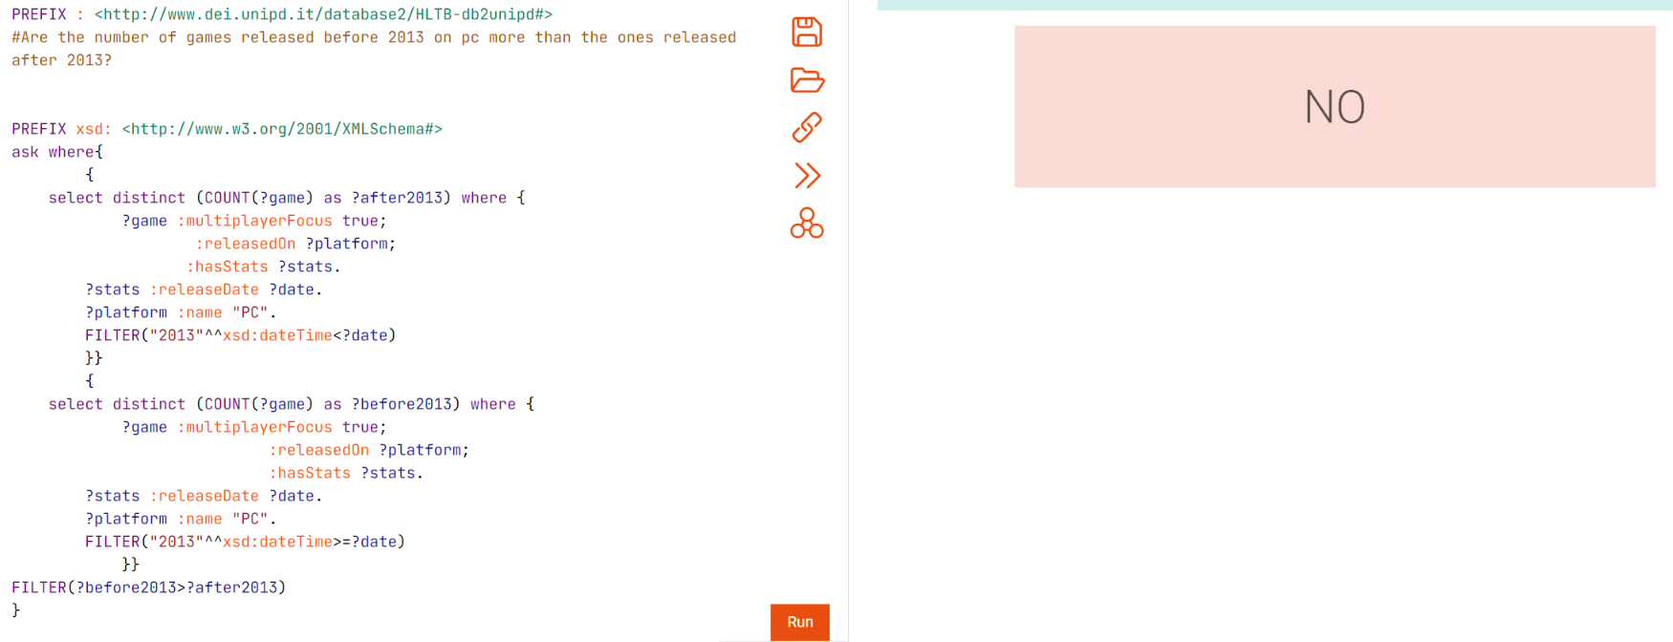
Query 3 - Are the number of games released before 2013 on PC more than the ones released after 2013?

Slide 13
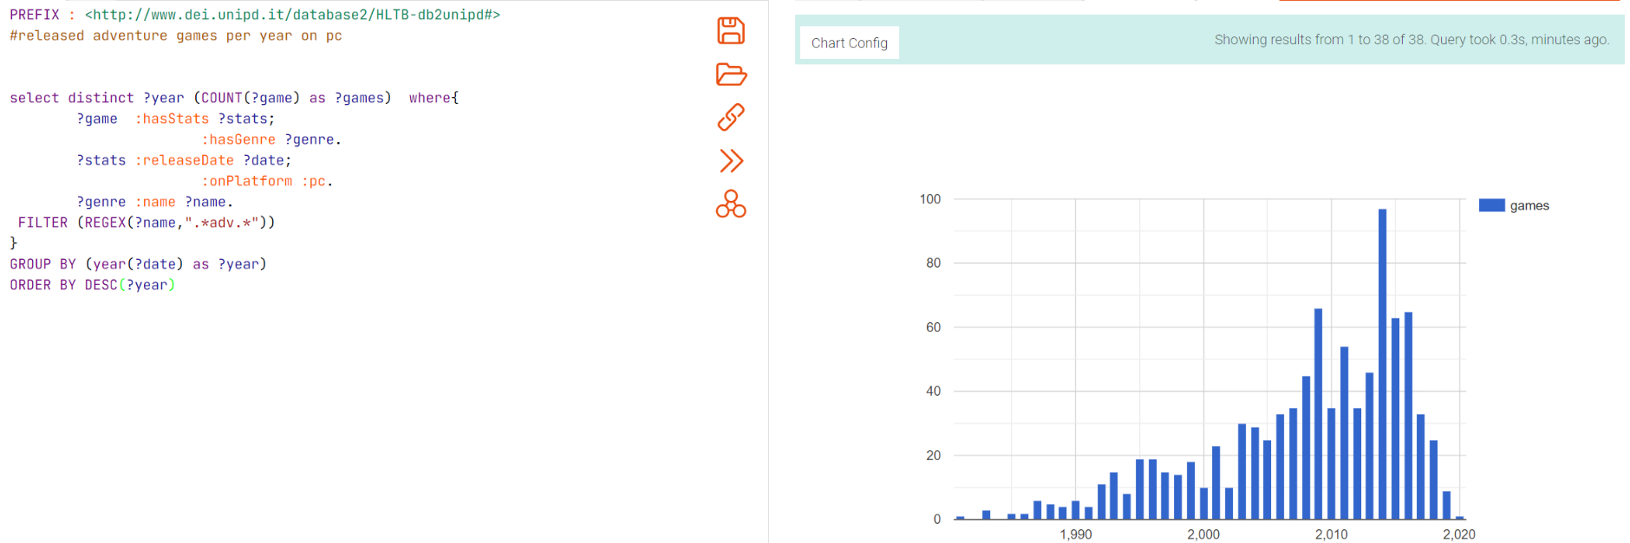
Query 4 - How many adventure games are released on pc?

Slide 14
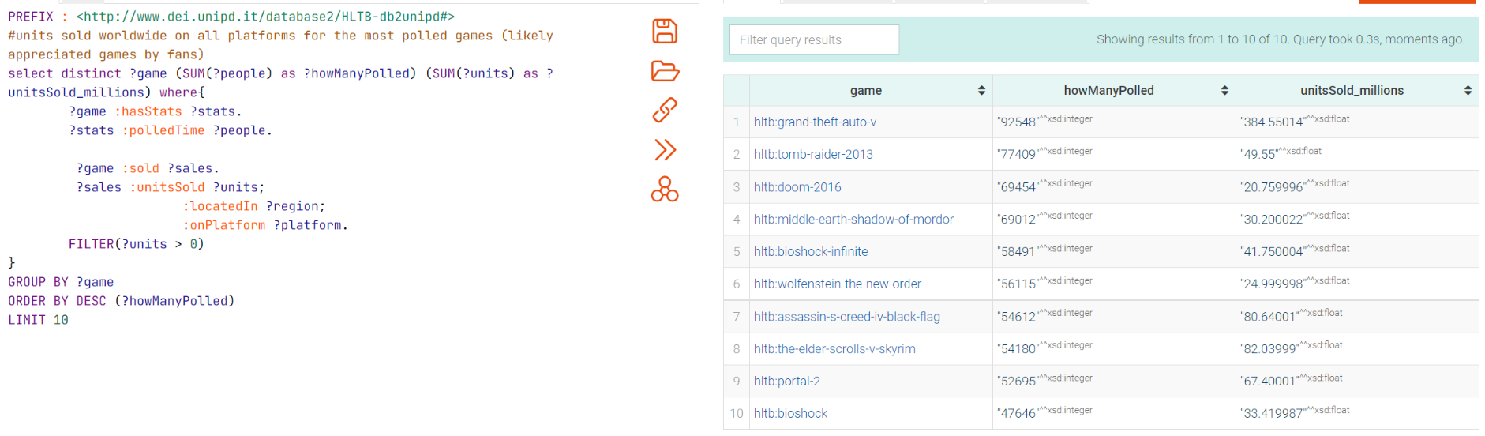
Query 5 - How many copies sold the most appreciated games ?

Slide 15
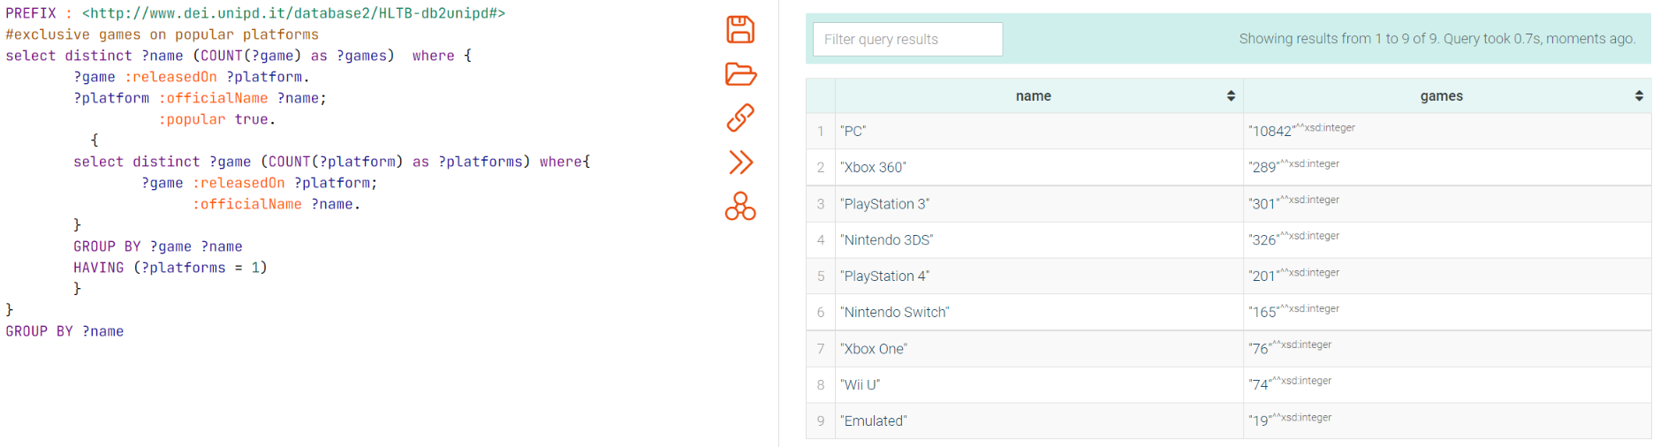
Query 6 - How many exclusive games each popular platform has?

Slide 16
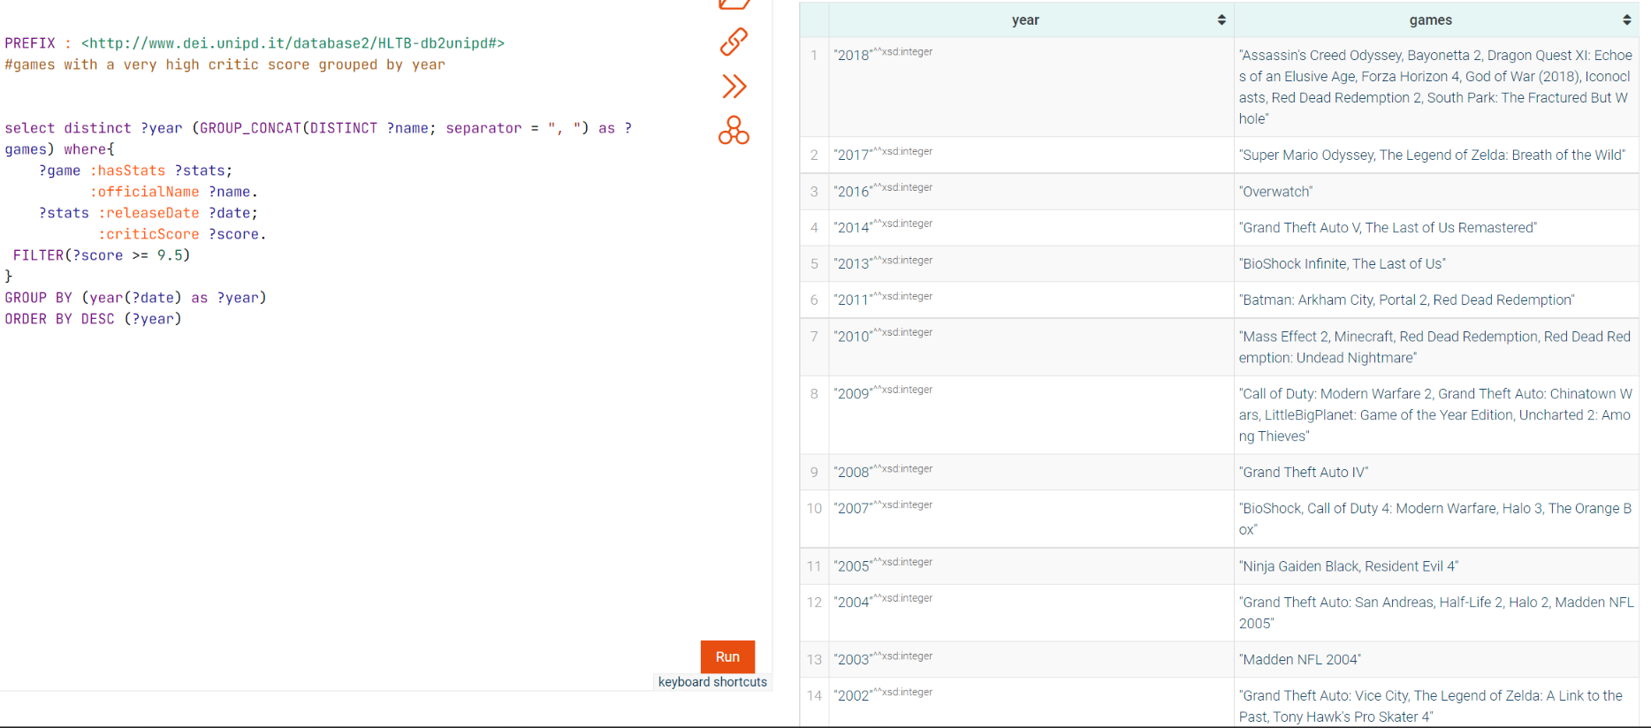
Query 7 - What are the most praised games by the critic?

Slide 17
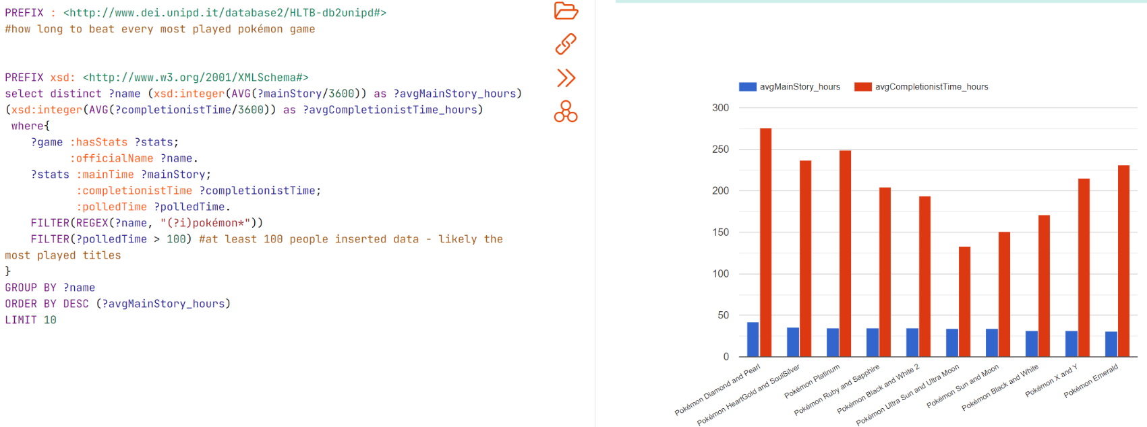
Query 8 - How long does it take to beat the most played Pokémon games?

Slide 18
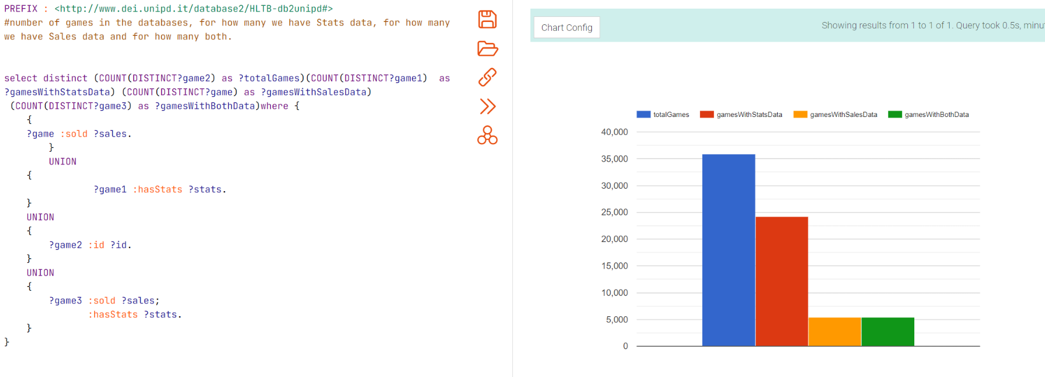
Total games and correlated data in the graph

Slide 19
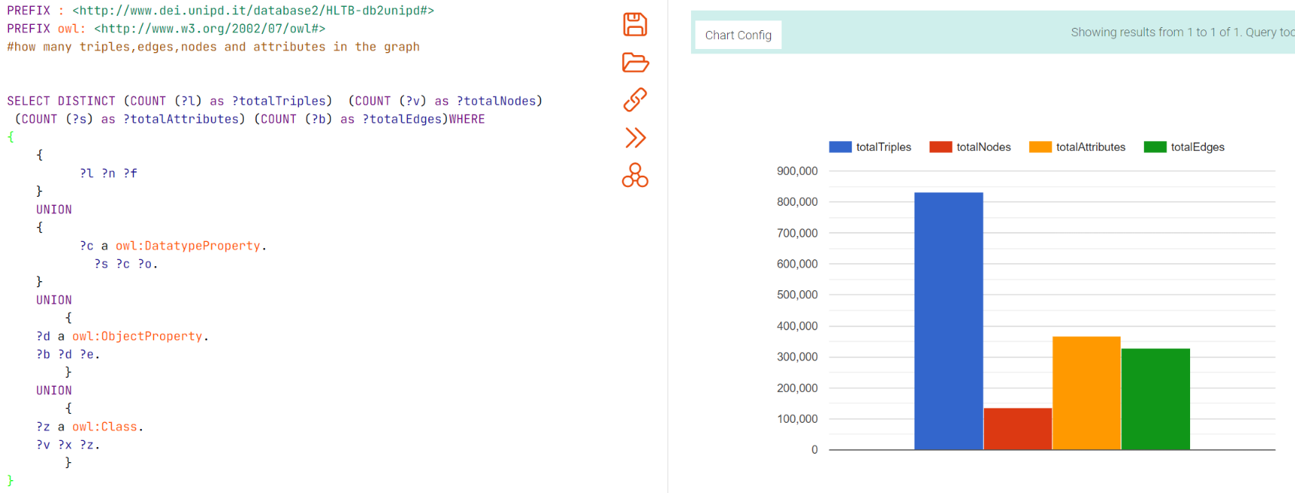
RDF Triples, Nodes, Attributes and Edges in the graph

Slide 20
Thank you for the attention!

